Slide 1




ECOMMERCE
CHURN
Presented by: Team 5

Slide 2


01
PROBLEM OVERVIEW
Customer churn is a major challenge for e-commerce businesses

Slide 3
01
PROBLEM OVERVIEW
Revenue Loss
Business Impact
High Acquisition Costs
Brand Reputation

Slide 4
02
OBJECTIVE
01
Identify at-risk customers using data-driven churn prediction models.
Analyze key factors influencing customer churn .
02
03
Enhance customer experience
04
Increase customer lifetime value (CLV) and reduce acquisition costs

Slide 5
03
FEATURES USED
Customer Demographics
CustomerID: Unique identifier for each customer
Gender: Male/Female
MaritalStatus: Single/Married

Slide 6
Customer Engagement & Behavior
Shopping & Order Preferences
PreferredLoginDevice
PreferredPaymentMode
PreferedOrderCat
CityTier
WarehouseToHome
Tenure
HourSpendOnApp
NumberOfDeviceRegistered
NumberOfAddress
DaySinceLastOrder

Slide 7
Shopping & Order Preferences
Transaction & Retention Insights
PreferredLoginDevice
PreferredPaymentMode
PreferedOrderCat
CityTier
WarehouseToHome
OrderCount
OrderAmountHikeFromLastYear
CouponUsed
CashbackAmount

Slide 8
Customer Satisfaction & Complaints
SatisfactionScore
Complain

Slide 9
Key Business Questions
1- How can we use the time since a customer’s last order to offer better discounts and marketing campaigns?
2-Do male and female customers shop differently? How can we use this insight?

Slide 10
Key Business Questions
3- Why do customers leave, and what signs can help us predict churn?
4 Does the distance between the warehouse and a customer’s home affect complaints?
5- Does the number of saved addresses impact customer loyalty?

Slide 11
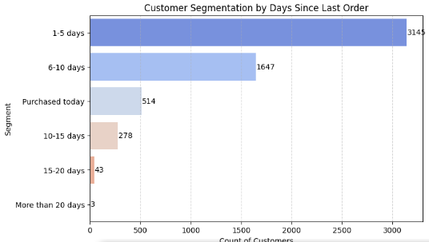
Customer Segmentation By Days Since Last Order

Slide 12
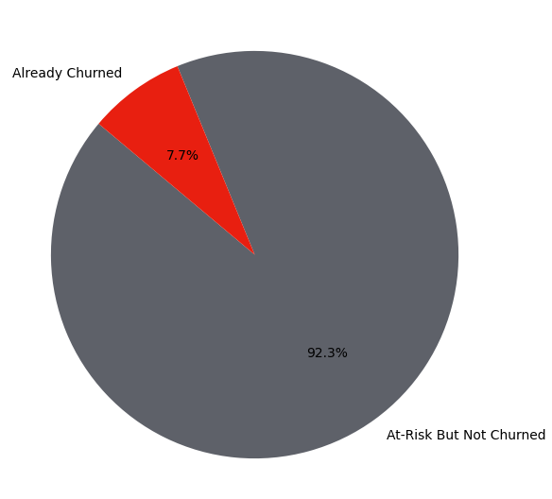
Risk Rate
Count of Customers at risk = 65
Count of Customers at risk & didn't churn = 60
Count of Customers at risk & churned already = 5

Slide 13
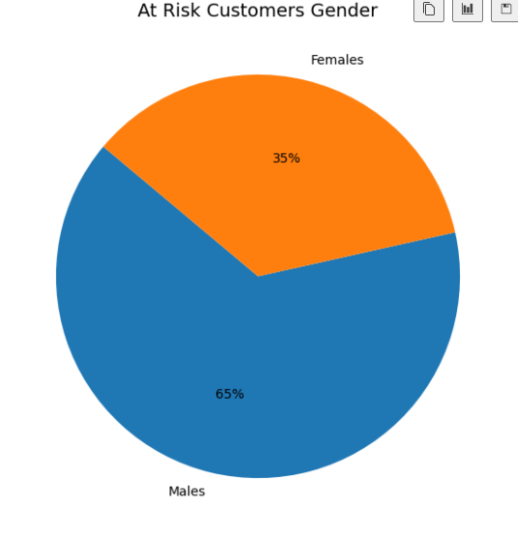
Risk Customers Gender
42 Males VS 23 Females
Business Actions
Create male-targeted offers
Use personalized emails, ads, and recommendations.
Implement loyalty programs tailored for male users.

Slide 14
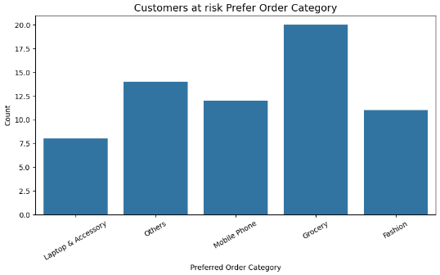
Risk Customers Prefer Order Category

Slide 15
Risk Customers Prefer Order Category
Business Actions
According to groceries:
Strengthen Grocery Sales
Increase Upselling & Cross-Selling: Recommend complementary products
Limited-Time Discounts

Slide 16
Risk Customers Prefer Order Category
Improve Laptop & Accessories Sales
Educate Customers
Seasonal & Event-Based Promotions: Target back-to-school, holiday sales, and business promotions for laptops.
Partner with Tech Influencers: Run campaigns with influencers reviewing or showcasing the products.

Slide 17
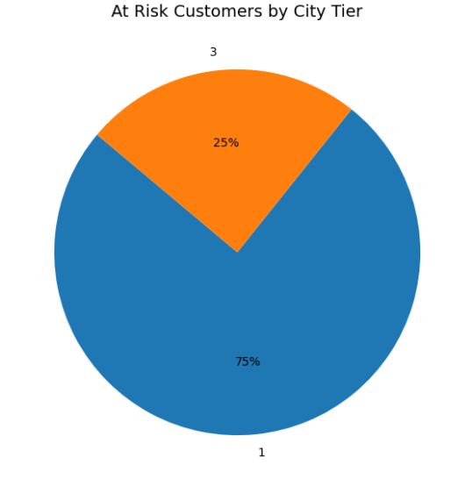
Risk Customers by City Tier
CityTier
Tier 1 Cities: high purchasing power and digital adoption.
Tier 3 Cities: Smaller towns with lower purchasing power but growing internet penetration

Slide 18
Risk Customers by City Tier
Recommendations for City Tier 1
focus on maintaining loyalty and increasing basket size.
Premiumization:
Use "exclusive" and "premium" messaging in ads.
Loyalty & Subscription Programs:
Offer VIP memberships for free delivery, early access to sales, or bonus rewards.

Slide 19
Risk Customers by City Tier
Recommendations for City Tier 3
Discounted & Affordable Pricing Strategy:
Localized Marketing Campaigns:
Use regional languages in ads and promotions.
Referral & Word-of-Mouth Programs:

Slide 20
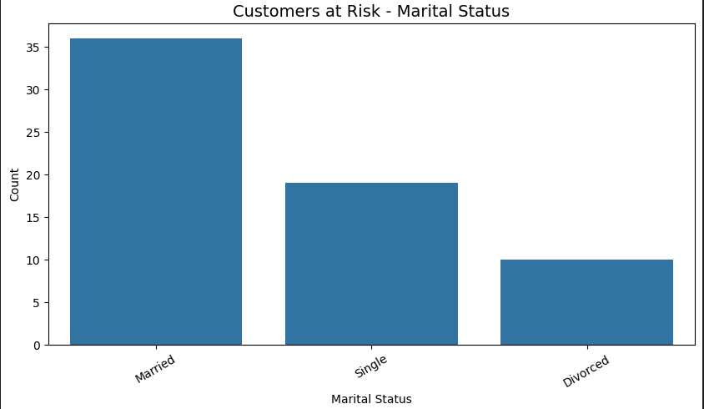
Risk Customers by Maital Status

Slide 21
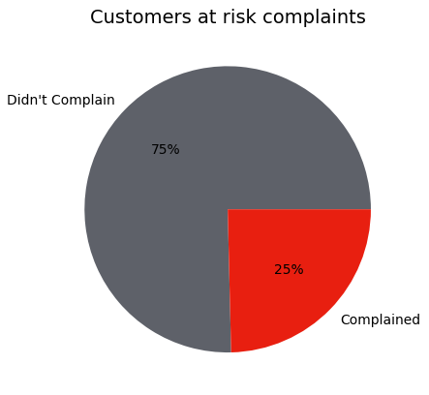
Complaints
Business Action
Competitive Benchmarking: Ensure your pricing, features, and customer service match or exceed competitors.

Slide 22
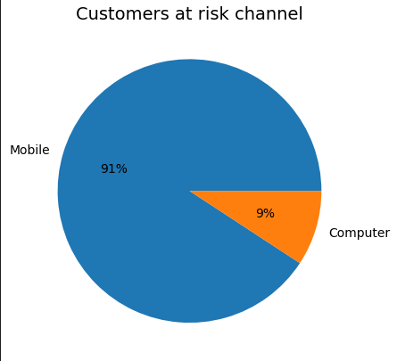
Used Channels
Business Action
1-Optimize Mobile UX & Performance
2-Push Notifications
3-Gamefication

Slide 23
What About Gender Based Behavior?

Slide 24
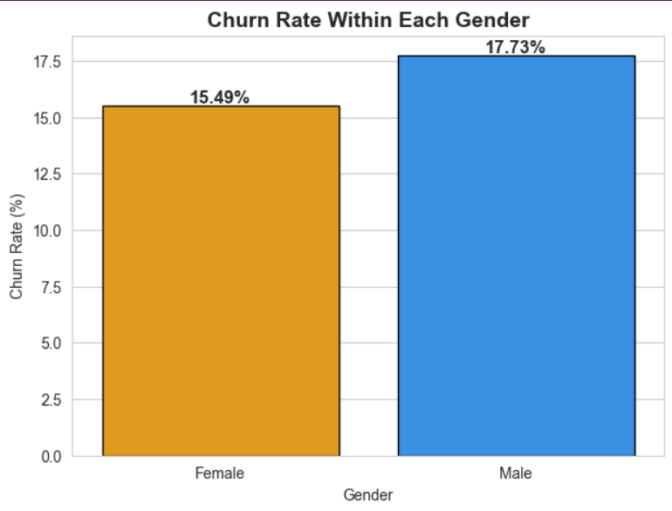
Churn Rate by Gender
Males have a higher churn rate (17.73%) compared to females (15.49%).
Business Actions
Understanding why males leave—survey churned customers to identify pain points.
Loyalty programs & personalized retention emails for male customers.

Slide 25
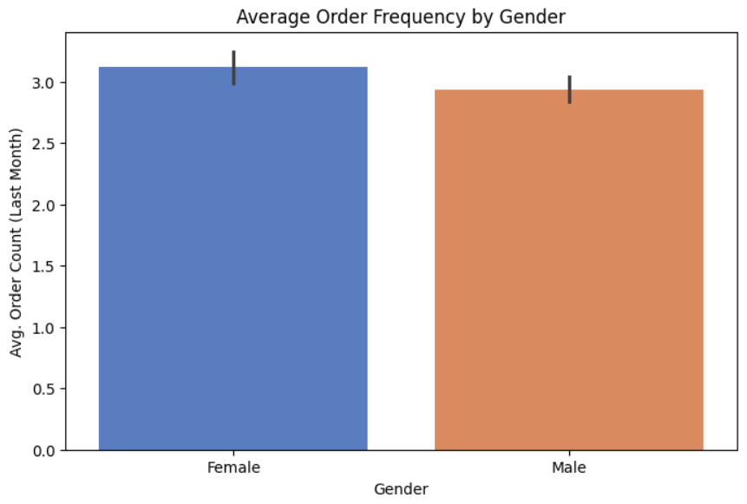
Average Order Frequency by Gender
Females order slightly more frequently than males.
Business Actions
Encourage male customers to order more frequently through personalized incentives.
Introduce premium membership programs with exclusive perks for frequent shoppers.

Slide 26
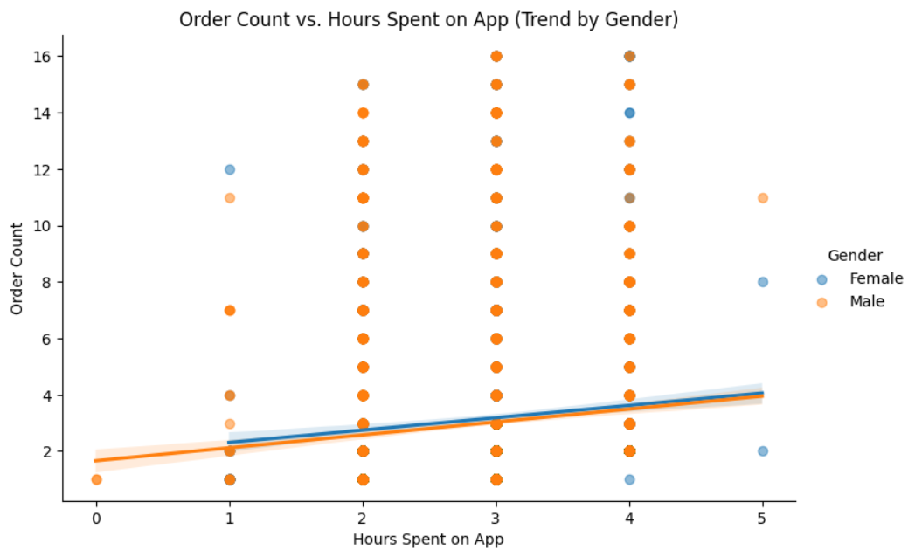
Order Count vs. Hours Spent on App (Trend by Gender)
A positive correlation exists between time spent on the app and order count for both genders.
Business Actions
Increase App Engagement through:
Introduce interactive features to keep users engaged.
Optimize the app experience (faster loading, better navigation) to retain users longer.

Slide 27
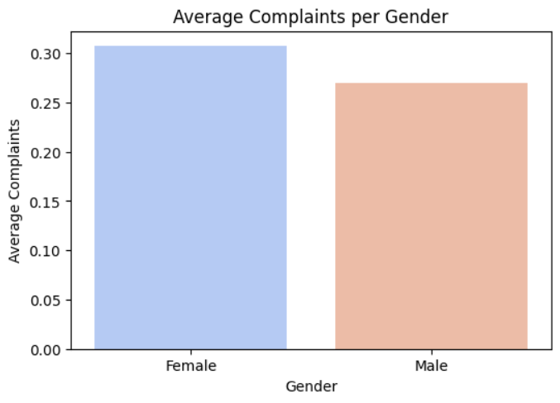
Average Complaints per Gender
Females have a slightly higher complaint rate.
Addressing complaints improves satisfaction and reduces churn.
Business Actions
Enhance customer support, especially for female shoppers.
Analyze common complaint types and proactively address issues.

Slide 28
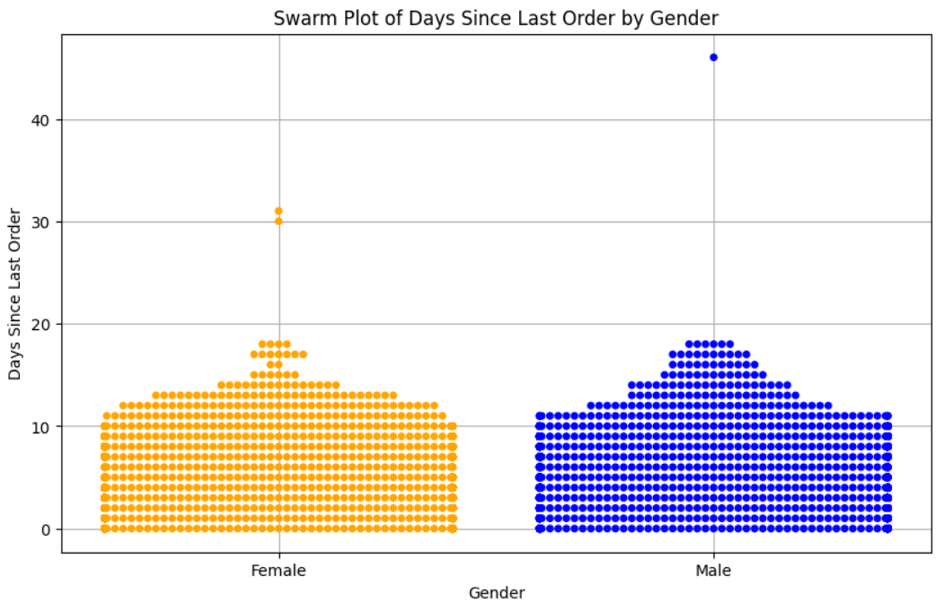
Days Since Last Order by Gender
Males tend to have slightly longer gaps between orders, with some extreme cases of long inactivity.
Business Actions
Offer personalized discounts or limited-time offers to encourage repeat purchases.
Create exclusive promotions for loyal customers to maintain their engagement.

Slide 29
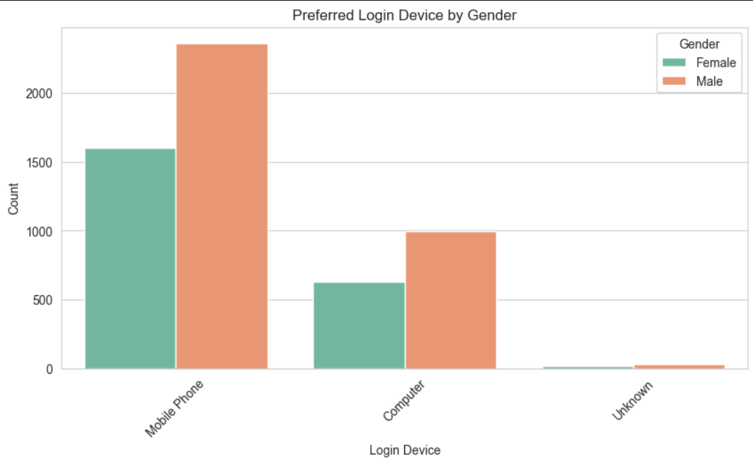
Preferred Login Device by Gender
Males and females both prefer mobile devices, but males have a stronger preference.
Business Actions
Optimize the mobile shopping experience (faster checkout, smoother UI).
Offer mobile-exclusive discounts to increase purchases

Slide 30
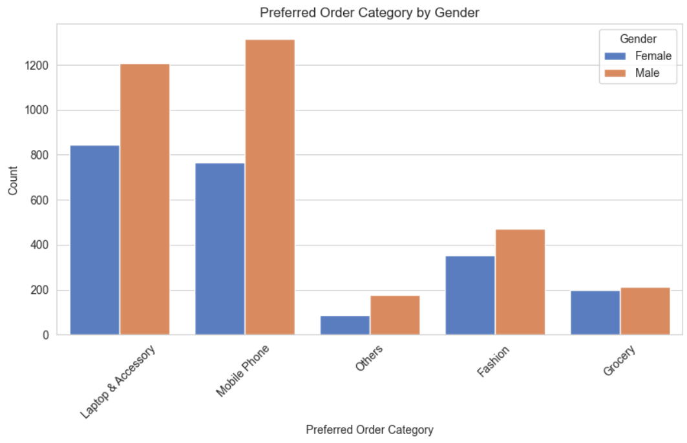
Preferred Order Category by Gender
Mobile Phones are the dominant for male customers.
Laptops & Accessories are the dominant for female customers.
Business Actions
Promote latest phone launches, gaming features, and high-performance specs for males.
Provide exclusive deals on accessories like bags and wireless devices for females

Slide 31
Why our customers churn and possible churn indicators ?

Slide 32
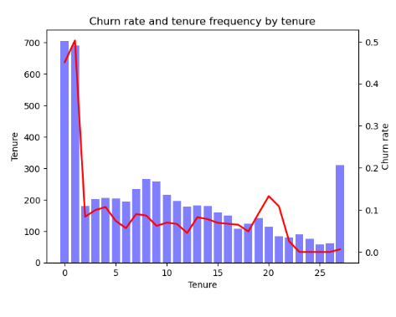
Tenure
Address High Early Churn
Goal: Reduce churn in the first year
Investigate Long-Term Churn Increase
Goal: Develop targeted retention strategies for long-term customers.

Slide 33
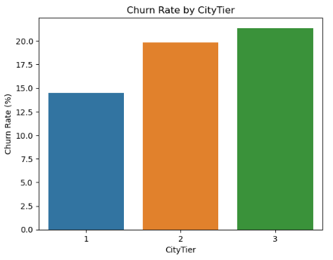
City Tier
Tier I:
Upsell & Cross-Sell
Tier II:
Provide rewards
Expand Payment Options:
Tier III:
offer low-cost plans or discounted subscriptions to encourage long-term engagement.

Slide 34
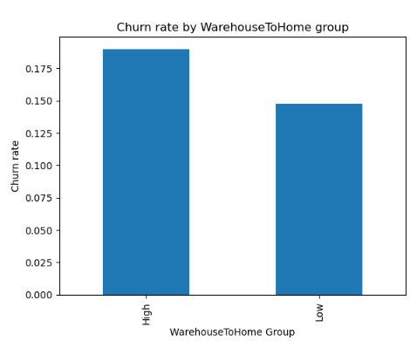
Warehouse To Home
Conduct surveys, interviews, and review analysis to understand why customers are churning.
Categorize feedback into common themes (e.g., pricing issues, service dissatisfaction, product quality).
Long delivery times?
Poor customer support?
High product/service cost?
Lack of desired features?

Slide 35
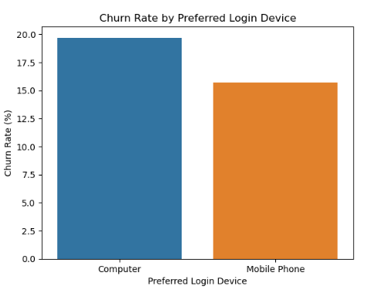
Preferred Login Device
Improve the Desktop User Experience
Align Features Across Devices
Provide interactive guides for first-time desktop users.
Gather feedback on pain points and expectations.
Push for Mobile Migration

Slide 36
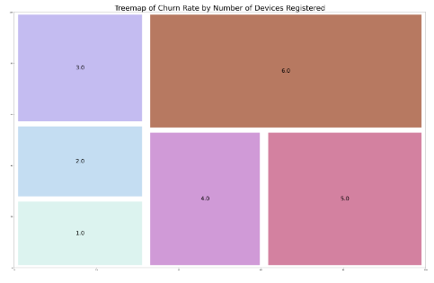
Number Of Device Registered
ACCOUNT SHARING & MULTIPLE USERS
INCREASED COMPLEXITY & FRUSTRATION
MORE OPPORTUNITIES TO NOTICE ISSUES
WORKPLACE VS. PERSONAL USE DISCREPANCY

Slide 37
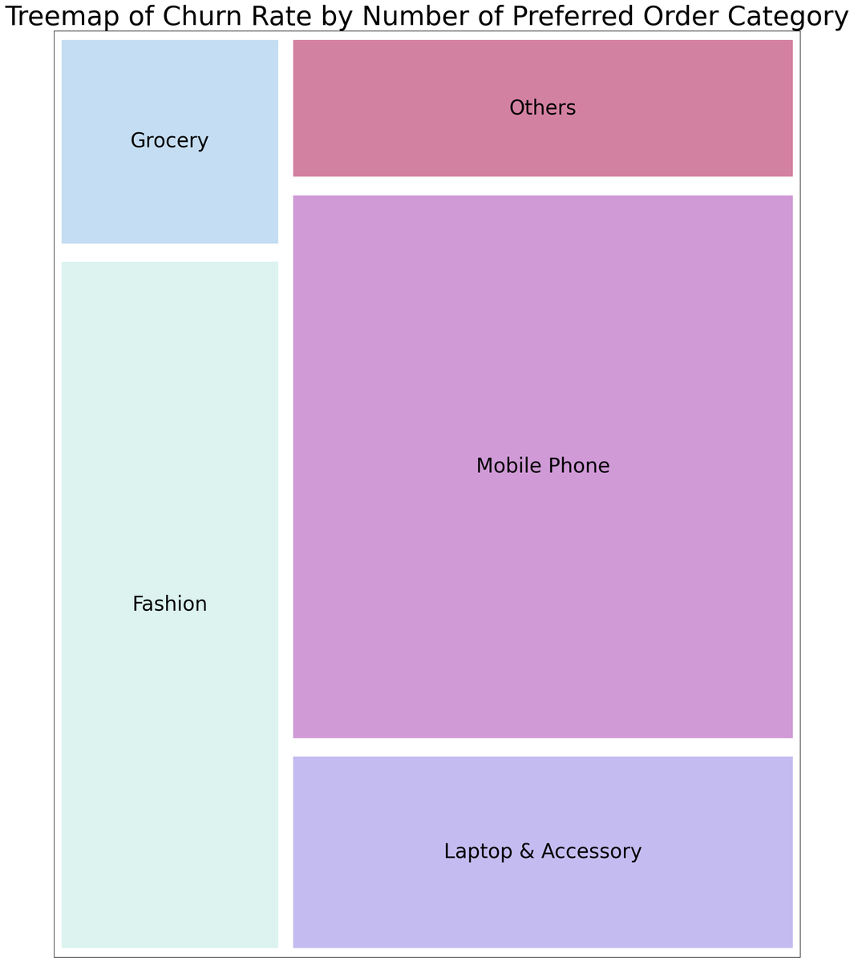
Prefered Order Cat
For Mobile & Laptops, focus on after-sales service, trade-in programs, and loyalty rewards.
For Fashion, improve size accuracy, personalized recommendations, and frequent new collection

Slide 38
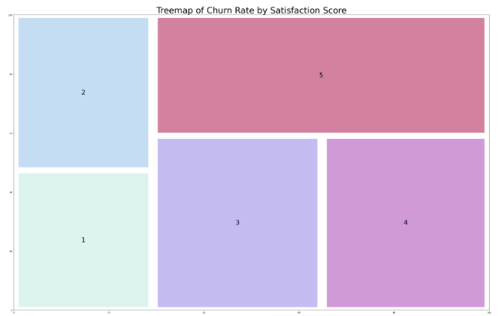
Satisfaction score
Paradoxical Churn:
High satisfaction,
High Loss
Business Actions
1) Investigate the root causes
2) Develop targeted retention programs
3) Refine customer experience

Slide 39
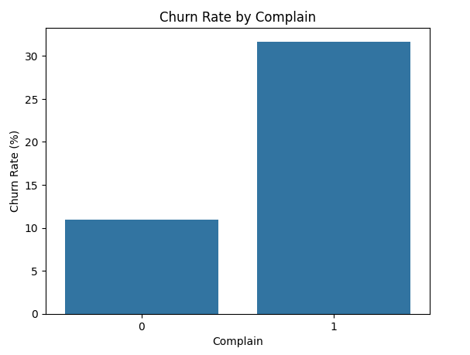
Complaints
Complaints as a Churn Predictor
Business Actions
1) Improve Complaint Resolution
2) Analyze Complaint Trends
3) Proactive Outreach

Slide 40
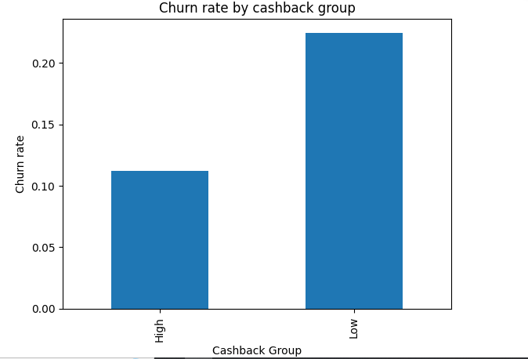
Cashback as a Churn Deterrent
Business Actions
1) Personalized Cashback Offers
2) Increase Customer Lifetime Value

Slide 41
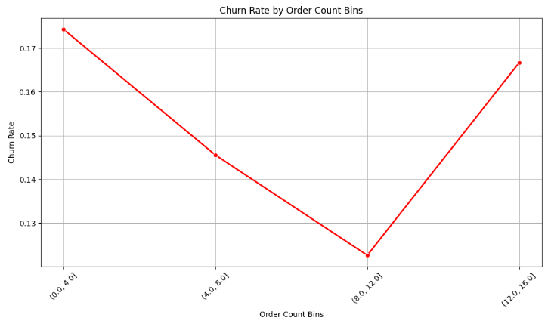
Customer churn in relation to purchase frequency.
Two Faces of Churn:
Early and Late Stage
Business Actions
1) Stay Fresh & Competitive
2) Loyalty Points & Rewards
3) Gather Feedback

Slide 42
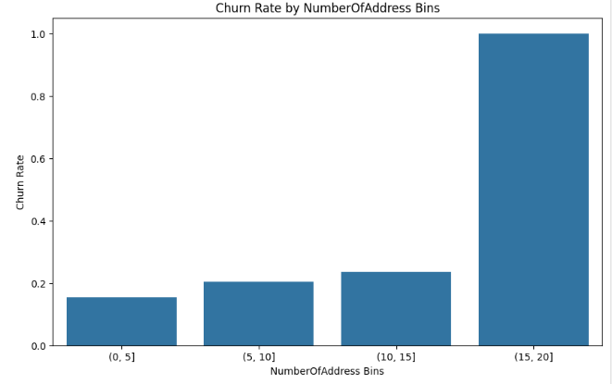
Number of stored addresses
More Addresses,
More Churn
Business Actions:
1) Enhance User Shipping Experience

Slide 43
Does the distance between warehouse and home impact complaints?

Slide 44
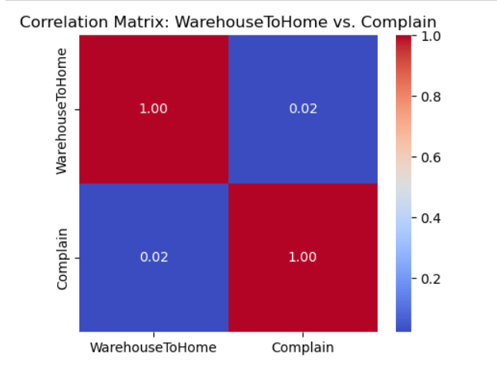
1- Minimal Correlation:

Slide 45
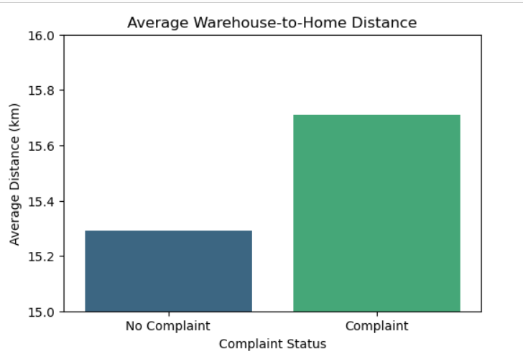
Similar Average Distances:

Slide 46
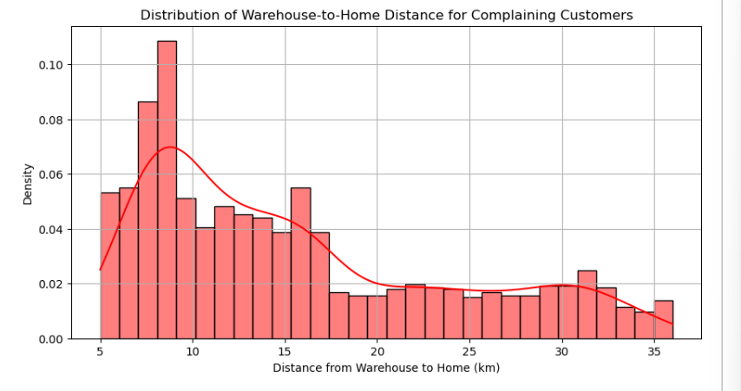
3. Distribution of Complaints Across Distances

Slide 47
Conclusion:
Our data-driven analysis demonstrates that the distance from the warehouse to the customer's home has little to no impact on the frequency of customer complaints

Slide 48
Recommendations:
Improve Delivery and Service Quality
Segment and Target Customers More Effectively

Slide 49
THANK YOU

